Slide 1
Graal: Univerzalni kompilator za dinamičke i statičke jezike
Vojin Jovanović
Senior Research Manager

Slide 2
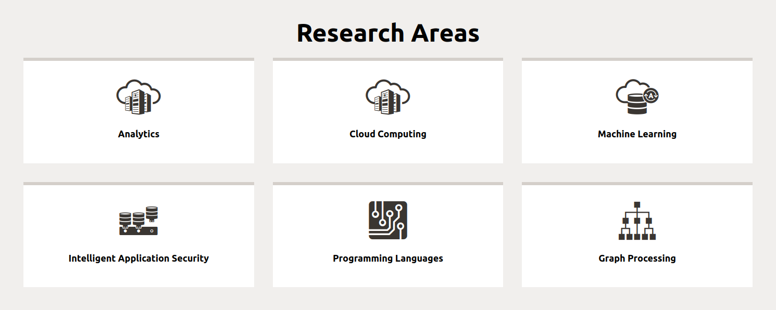

Oracle Labs: Oblasti istraživanja i lokacije

Slide 3
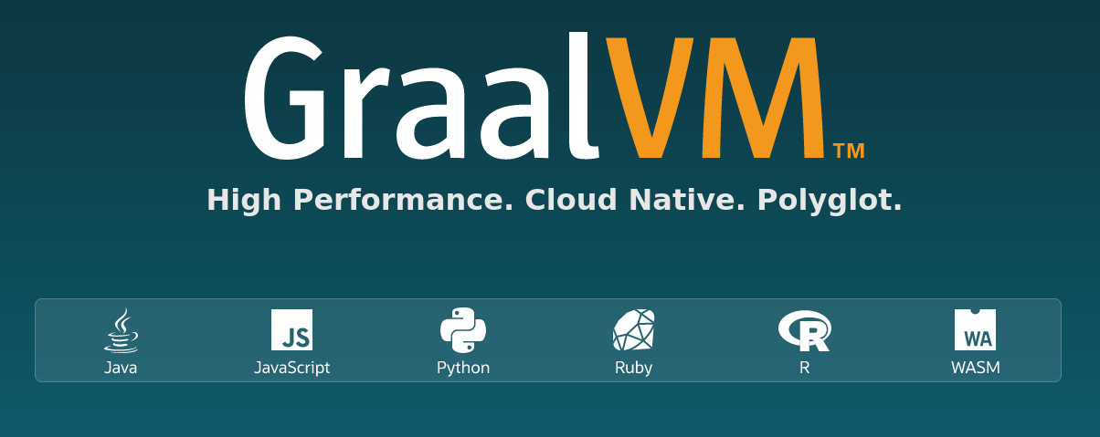

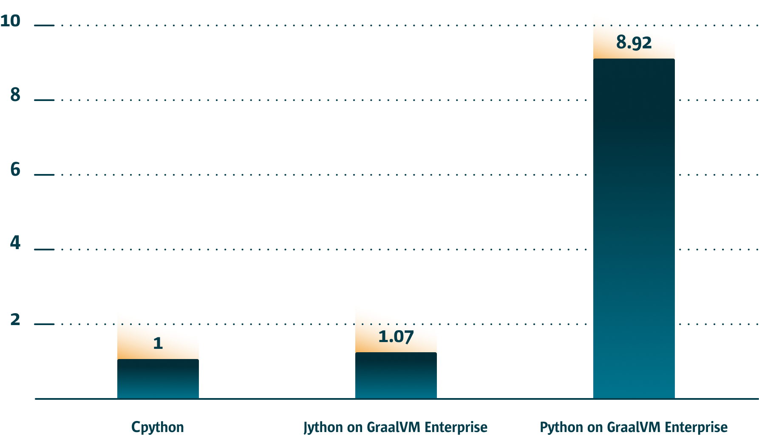

Neki od uspešnih projekata u Oracle Labs

Slide 4
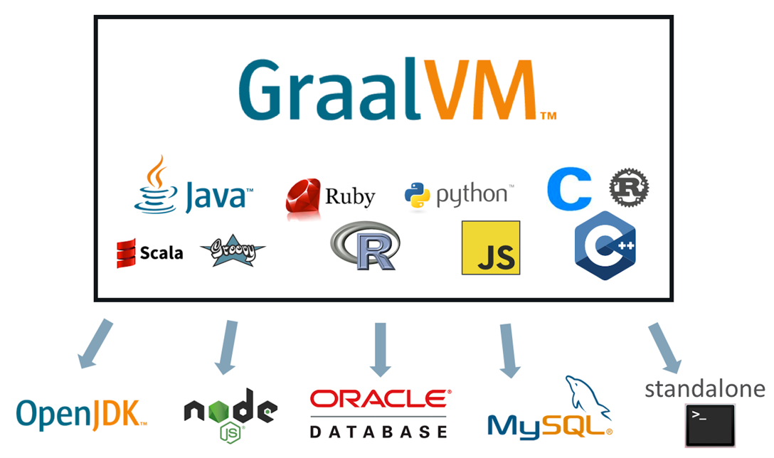
GraalVM: Run Programs Faster Anywhere

Slide 5
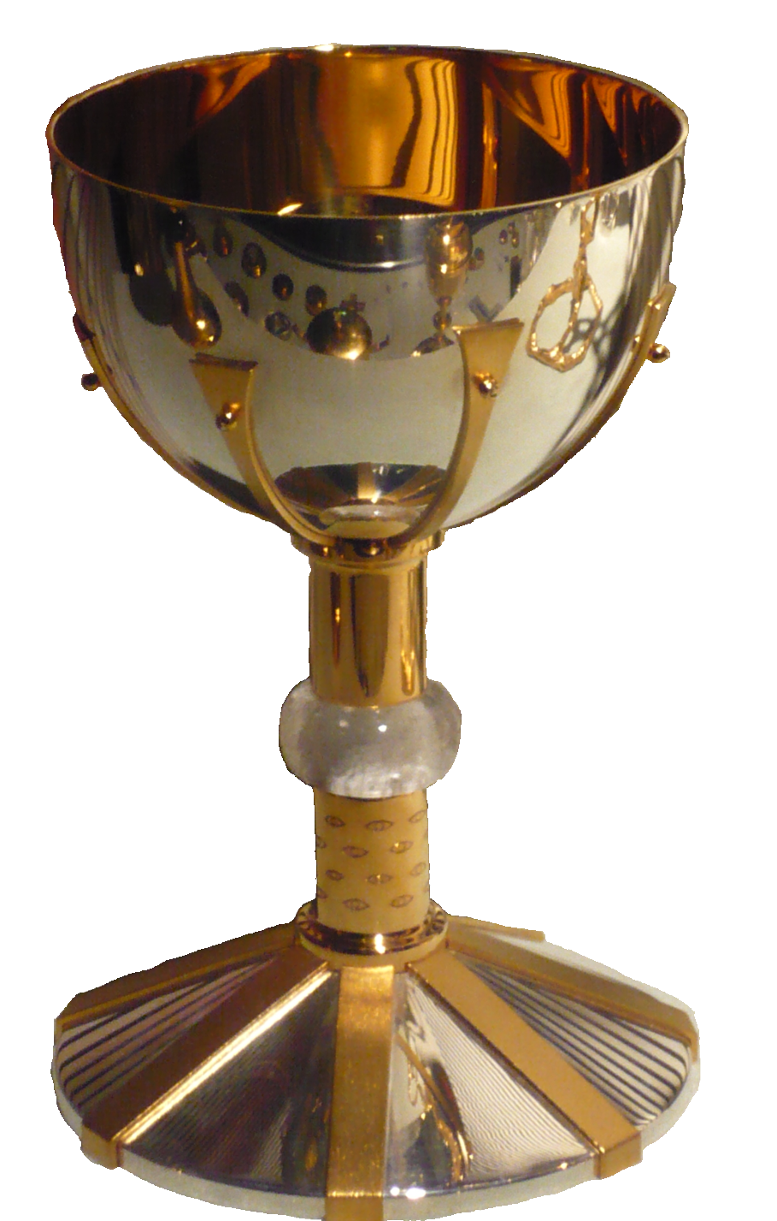
Graal: One Compiler for all Managed Languages

Slide 6
Key Features of Graal
Written in Java
  Eases development and maintenance
Modular architecture
  Configurable compiler phases
  Compiler-VM separation: snippets, provider interfaces
Designed for code that is accompanied with execution profiles
Aggressive high-level optimizations
Sea-of-nodes intermediate representation with seamless visualization
Designed for speculative optimizations and deoptimization
  Metadata for deoptimization is propagated through all optimization phases
Designed for exact garbage collection
  Read/write barriers, pointer maps for garbage collection

Slide 7
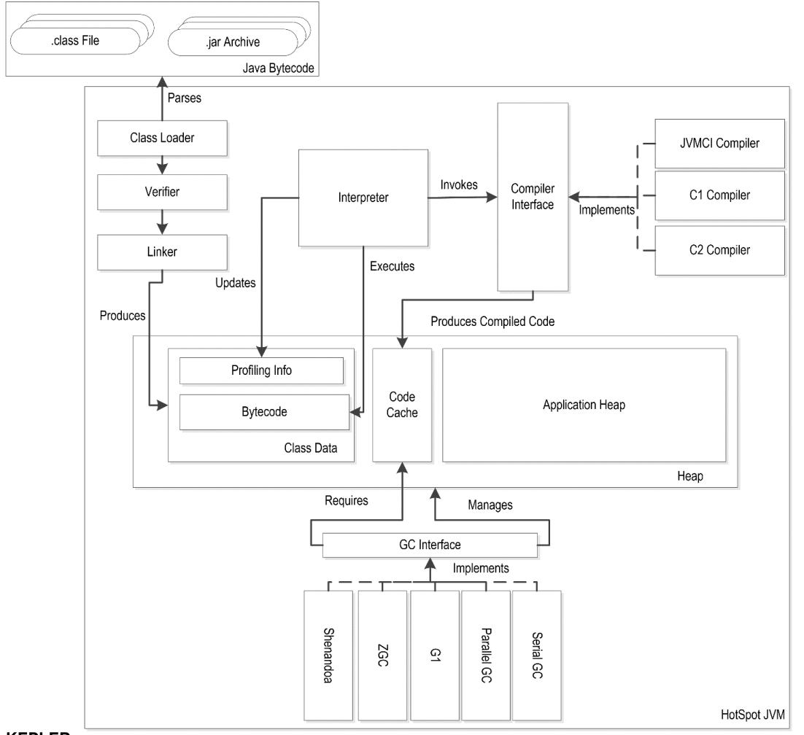
Managed Runtimes: Java Virtual Machine

Slide 8
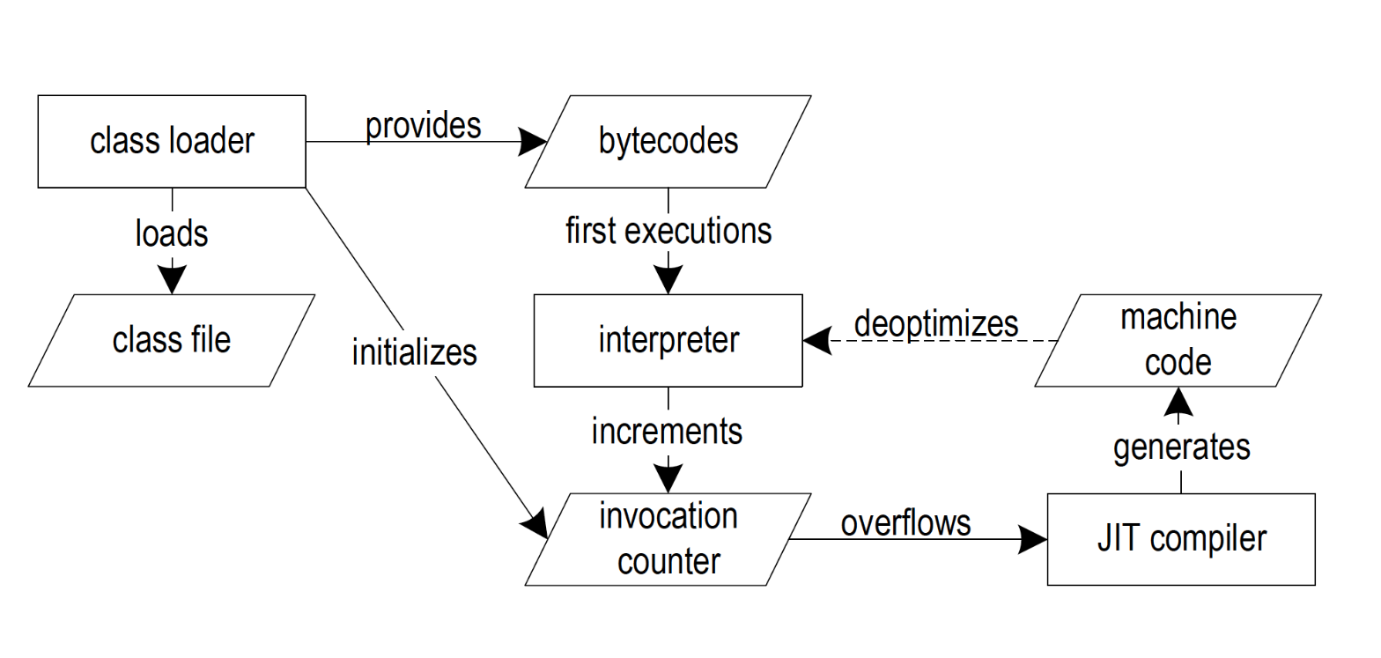
Managed Runtimes: Code Execution

Slide 9
Profiling the Code in the Interpreter
Besides program execution the interpreter:
- Counts method execution
- Profiles branch probabilities
- Profiles virtual-invoke receiver type
- Counting caught exceptions
The collected profiles are typically:
- Collected in a context insensitive manner
- Are collected without synchronization
As a result profiles are:
- Often polluted in important places
- Inaccurate for highly concurrent programs
public static double surface(Shape[] shapes) {
// called 10000 times => triggers compilation
double res= 0.0d;
// [then: 990000, else: 10000]
try {
for (int i = 0; i < shapes.length; i++) {
// types: {Square: 100, Circle: 99900]
res += shapes[i].surface()
}
} catch(Exception e) {
// [exception: 0]
return -1;
}
return res;
}

Slide 10
Aggressive Optimizations: Partial Escape Analysis
public static Car getCached(int hp, String name) {
Car car = new Car(hp, name, null);
Car cacheEntry = null;
for (int i = 0; i < cache.length; i++) {
if (car.hp == cache[i].hp &&
car.name == cache[i].name) {
cacheEntry = cache[i];
break;
}
}
if (cacheEntry != null) {
return cacheEntry;
} else {
addToCache(car);
return car;
}
}
Slow path

Slide 11
Aggressive Optimizations: Partial Escape Analysis
public static Car getCached(int hp, String name) {
Car cacheEntry = null;
for (int i = 0; i < cache.length; i++) {
if (hp == cache[i].hp &&
name == cache[i].name) {
cacheEntry = cache[i];
break;
}
}
if (cacheEntry != null) {
return cacheEntry;
} else {
Car car = new Car(hp, name, null);
addToCache(car);
return car;
}
}
new Car(...) escapes at:
  addToCache(car);
  return car;
Might be a very unlikely path
No allocation on hot path
Partial escape analysis and scalar replacement for Java.
Slow path
Stadler et al., CGO 14', Partial escape analysis and scalar replacement for Java.

Slide 12
Aggressive Optimizations: Simulation-Based Path Duplication
def f(a: Int, b: Int, x: Array[Int]) = {
var p: Int = _
if (a > b) {
p = a
} else {
p = 2
}
x.length / p
}
Slow path
p = 2 in the
false branch
Fast path
Strength reduction:
if we know p == 2
and x.length > 0
x.length / 2 ⬄ x.length >> 1
Expensive operation

Slide 13
Aggressive Optimizations: Simulation-Based Path Duplication
Cost-benefit analysis for duplication based on a cost model
  Benefit: (Latency(Div) - Latency(Shift)) * Frequency = 31 * 0.9 = 27.9
  Cost: 5 instructions
    Add 1 Additional Return (+ 4 Instructions) + 1 Additional Shift + 1 Additional Read
    Subtract 1 Jump from branch
def f(a: Int, b: Int, x: Array[Int]) =
if (a > b) {
x.length / a;
} else {
x.length >> 1;
}
One order of magnitude faster on Intel CPUs
Leopoldseder et al., CGO 18', Dominance-basedduplication simulation (DBDS): code duplication to enable compiler optimizations

Slide 14
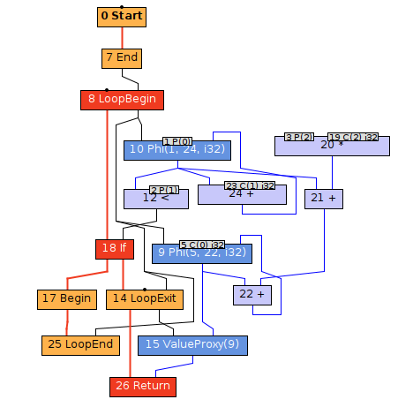
Sea-of-Nodes Intermediate Representation
Graph representation of the code
Does not impose a schedule before the final stage
Nodes are organized in a class hierarchy
Fixed nodes for control flow
Floating nodes for data flow
Simplifies optimizations:
Dead code elimination by design
Common subexpression elimination becomes easy
Duboscq et al., VMIL '13, An intermediate representation for speculative optimizations in a dynamic compiler

Slide 15
Managed Runtimes: Safepoints
Managed runtimes can bring all threads to a stop (Stop-the-World operation)
Each thread checks if it should stop at:
Loop back edges
Before each function return
After returning from native code
When all threads are at a safepoint a VM can access the stacks of all threads
At a safepoint we must know where each reference is stored on the stack
Reasons to stop threads on a safepoint are:
Garbage collection
Certain deoptimizations that affect multiple methods (e.g., locking assumptions)
Thread dumps and heap dumps
Delay between requesting a safepoint and all threads stopping should be low
Safepoints should not introduce noticeable performance overheads

Slide 16
Deoptimization and Speculative Optimizations
Simplifies compiler graphs and hence allows better optimizations
Need to track interpreter-frame mapping throughout the compiler pipeline
At every deoptimization point we must know the mapping between the stack and registers, and the interpreter frame slots
Increases complexity of the compiler
Requires tracking of deoptimization metadata
Increases the memory footprint
for (int anInt : ints) {
if (anInt < 0) {
if (negAdjust == null) {
throw new NullPointerException();
}
sum += negAdjust;
}
sum += anInt;
}
if (negAdjust == null) deoptimize;
for (int anInt : ints) {
if (anInt < 0) {
sum += negAdjust;
}
sum += anInt;
}

Slide 17
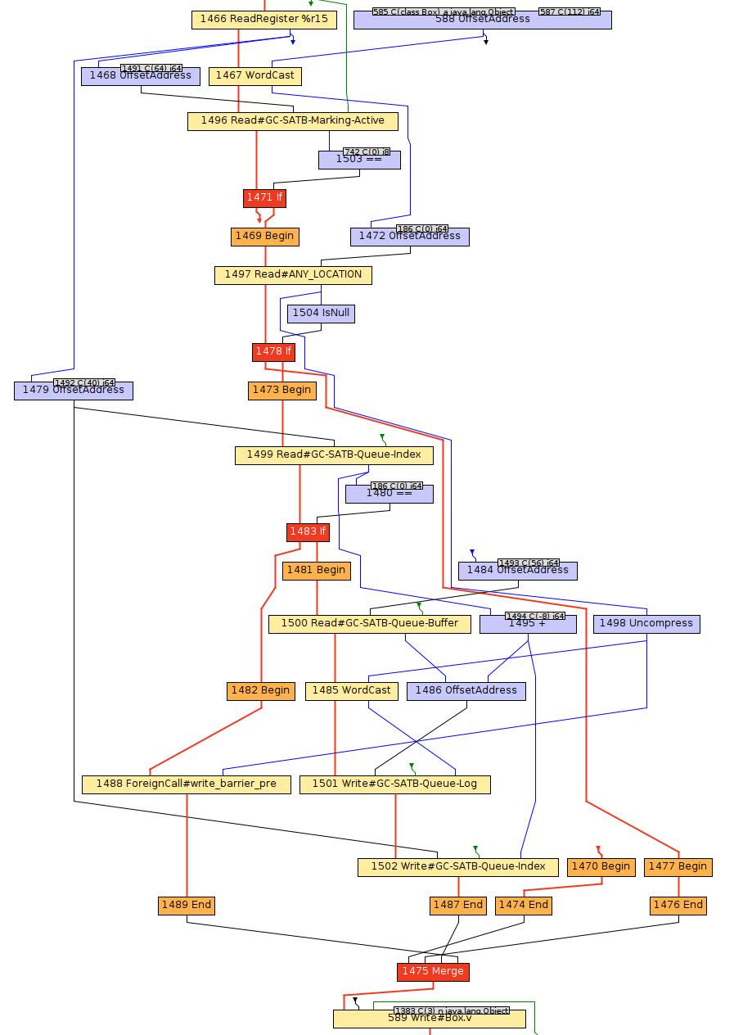
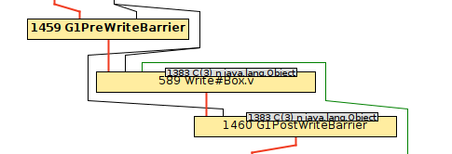
Managed Runtimes: Garbage Collection
Each allocation can trigger a garbage collection (GC)
To start a GCs all threads need to be brought to a safepoint
Metadata is needed to know what are the references (reference maps)
All references on the stack and registers are roots
Precise GCs make a distinction between a reference and a primitive
Object headers often require extra bits for tracking GC state
Compiled code often introduces non-trivial write barriers, and sometimes read barriers
Managed-memory apps are sometimes faster and sometimes slower than unmanaged apps
After lowering

Slide 18
Summary: Key Features of Graal
Written in Java
  Eases development and maintenance
Modular architecture
  Configurable compiler phases
  Compiler-VM separation: snippets, provider interfaces
Designed for code that is accompanied with execution profiles
Aggressive high-level optimizations
Sea-of-nodes intermediate representation with seamless visualization
Designed for speculative optimizations and deoptimization
  Metadata for deoptimization is propagated through all optimization phases
Designed for exact garbage collection
  Read/write barriers, reference maps for garbage collection

